Slide 1
Module 4
Introduction to Artificial Neural Networks: Biological Neuron, Perceptron, Training, limitations, XOR problem,
Multilayer perceptron,
Gradient based learning, stochastic gradient descent,
Activation Functions-Sigmoid, ReLU, tanh.
Back propagation- Chain rule, Regularization- L1, L2,

Slide 2
Introduction to Artificial Neural Networks
Artificial Neural Networks (ANNs) are computer systems designed to mimic how the human brain processes information.
Just like the brain uses neurons to process data and make decisions, ANNs use artificial neurons to analyze data, identify patterns and make predictions.
These networks consist of layers of interconnected neurons that work together to solve complex problems.
The key idea is that ANNs can "learn" from the data they process, just as our brain learns from experience.

Slide 3
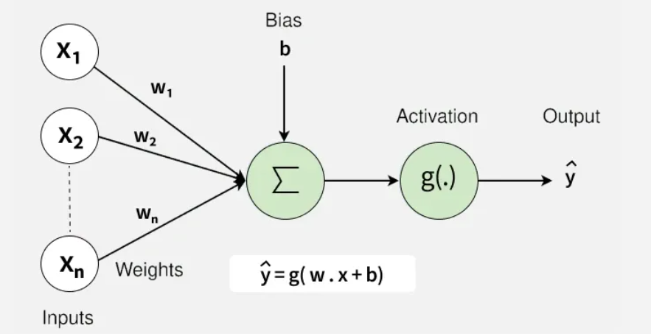
Introduction to Artificial Neural Networks

Slide 4
Neural networks: key components
Neurons: The basic units that receive inputs, each neuron is governed by a threshold and an activation function.
Connections: Links between neurons that carry information, regulated by weights and biases.
Weights and Biases: These parameters determine the strength and influence of connections.
Propagation Functions: Mechanisms that help process and transfer data across layers of neurons.
Learning Rule: The method that adjusts weights and biases over time to improve accuracy.

Slide 5
Introduction to Artificial Neural Networks
Learning in neural networks follows a structured, three-stage process
Input Computation: Data is fed into the network.
Output Generation: Based on the current parameters, the network generates an output.
Iterative Refinement: The network refines its output by adjusting weights and biases, gradually improving its performance on diverse tasks.
In an adaptive learning environment:
The neural network is exposed to a simulated scenario or dataset.
Parameters such as weights and biases are updated in response to new data or conditions.
With each adjustment, the network’s response evolves allowing it to adapt effectively to different tasks or environments.

Slide 6
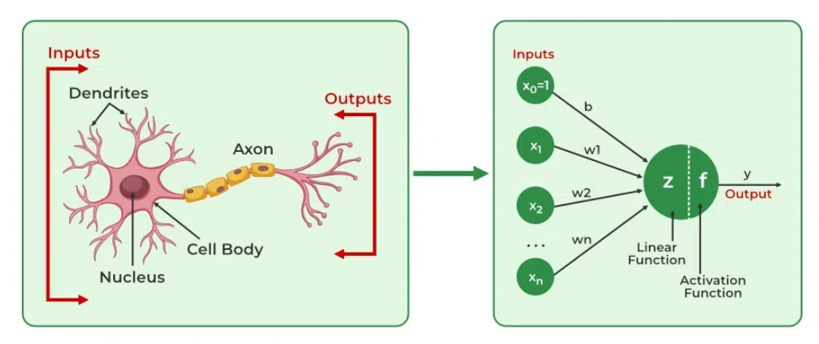
Biological Neuron - Artificial Neural Networks

Slide 7
Biological Neuron

Slide 8
Biological Neuron
It is composed of a cell body containing
Nucleus and most of the cell’s complex components
Many branching extensions called dendrites
One very long extension called the axon
The axon’s length may be just a few times longer than the cell body, or up to tens of thousands of times longer.
Near its extremity the axon splits off into many branches called telodendria
At the tip of these branches are minuscule structures called synaptic terminals (or simply synapses), which are connected to the dendrites or cell bodies of other neurons.

Slide 9
Biological Neuron
Biological neurons produce short electrical impulses called action potentials (APs, or just signals) which travel along the axons and make the synapses release chemical signals called neurotransmitters.
When a neuron receives a sufficient amount of these neurotransmitters within a few milliseconds, it fires its own electrical impulses (actually, it depends on the neurotransmitters, as some of them inhibit the neuron from firing).
They are organized in a vast network of billions, with each neuron typically connected to thousands of other neurons.
Highly complex computations can be performed by a network of fairly simple neurons

